Slide 1
Impact of LFX Mentorship : My learnings at Carvel and the journey beyond
Ashish Kumar
@ashpect

Slide 2
About Me
Ashish Kumar
- Undergrad@ Indian Institute of Technology Roorkee
- developer at SDSLabs (sdslabs.co)
- LFX Mentee’23
- Gsoc ‘24
Interest
- Cloud Native Technologies/DevOps
- Backend Developer (Go/C++/Js)
- Zero-Knowledge Applications
- Depth vs Trying things out
ashpect.me

Slide 3
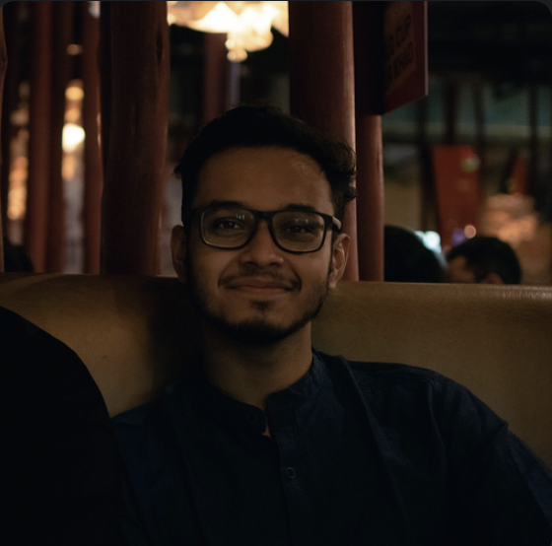
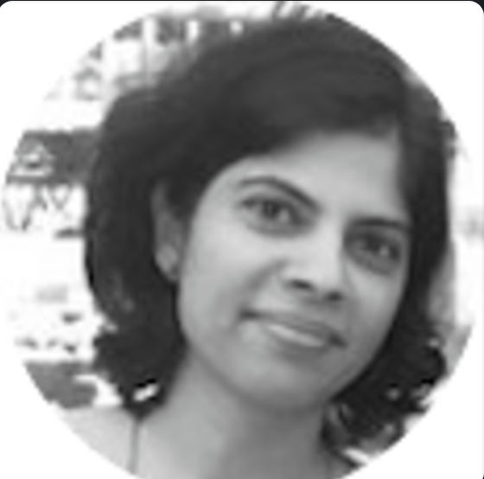
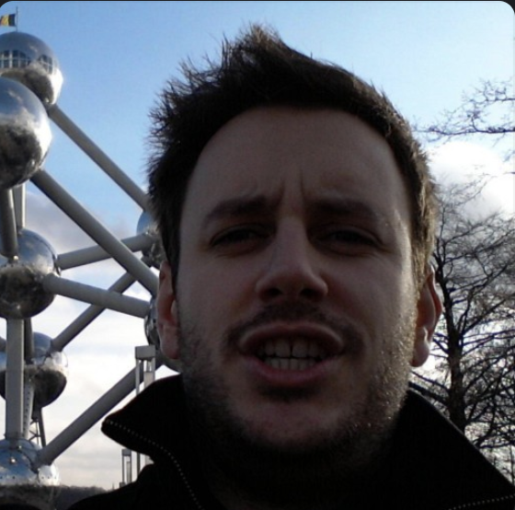
Mentors
Soumik Majumdar
Renu Yarday
Joao Pereira

Slide 4


Slide 5

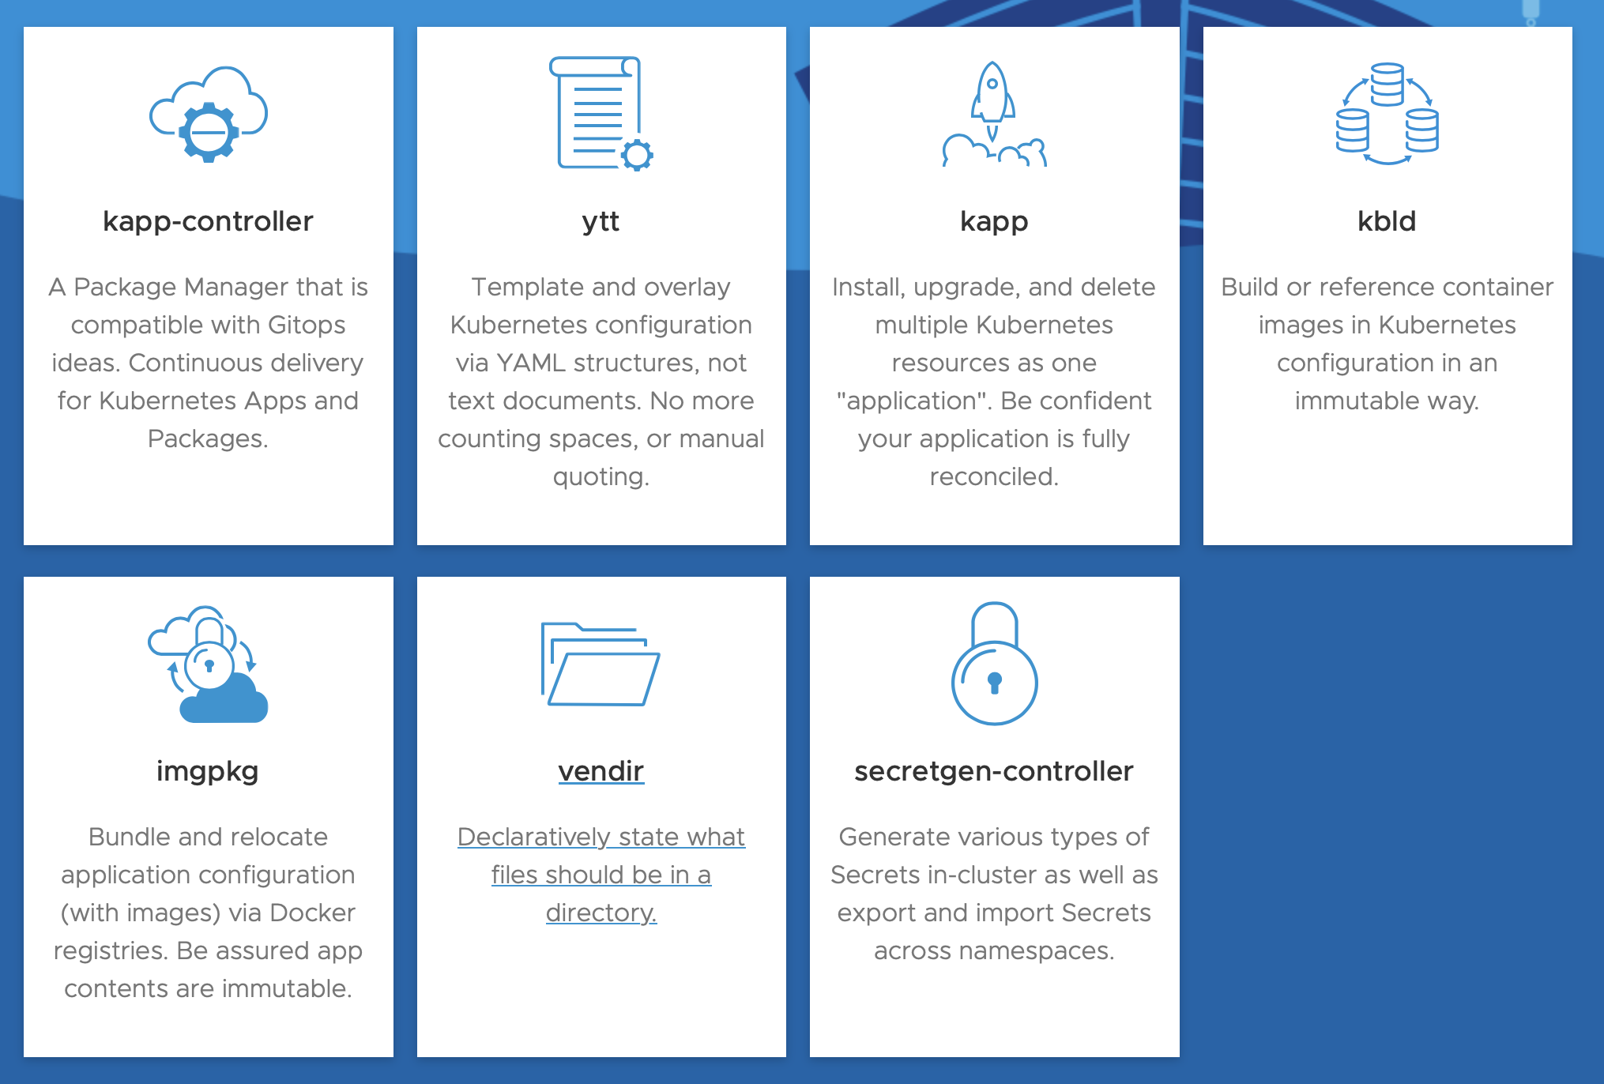
The Carvel Philosophy ?
https://carvel.dev
- Carvel is a set of reliable, single-purpose, composable tools.
- 7 tools - Cli’s and the controllers.
Notes:
The problem we’re fixing is basically to give tools to solve smaller subproblems which can compose to solve a bigger problem without any leaky abstractions. The Unix philosophy, eg: Unix cli commands. So yeah, you can use it for deploying, managing, configuring etc.

Slide 6
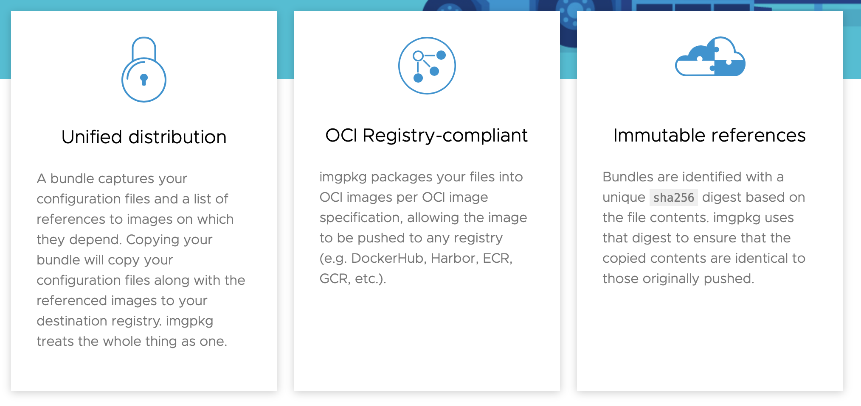
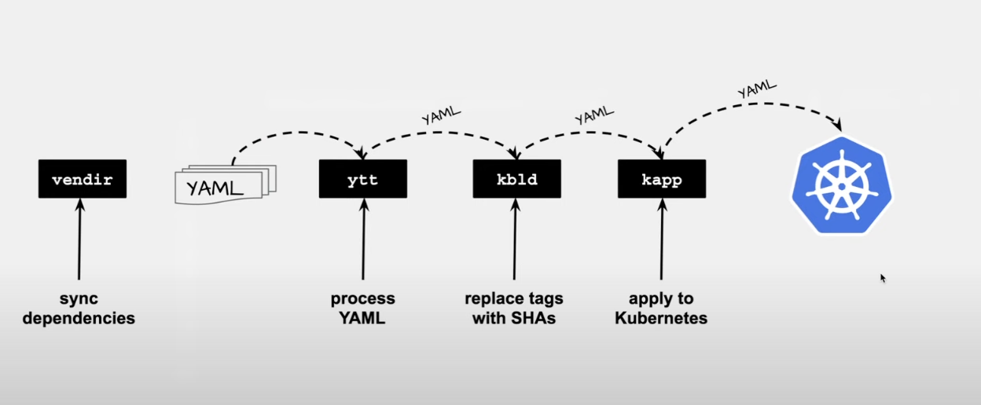
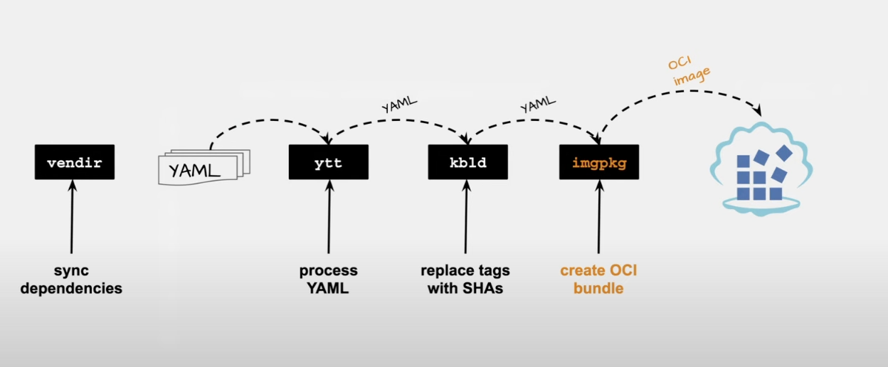
Imgpkg
https://carvel.dev/imgpkg
Package, distribute, and relocate your Kubernetes configuration and dependent OCI images as one OCI artifact: a bundle.
Consume bundles with confidence that their contents are unchanged after relocation.
Notes:
Package your application so that deployer can deploy in their cluster

Slide 7
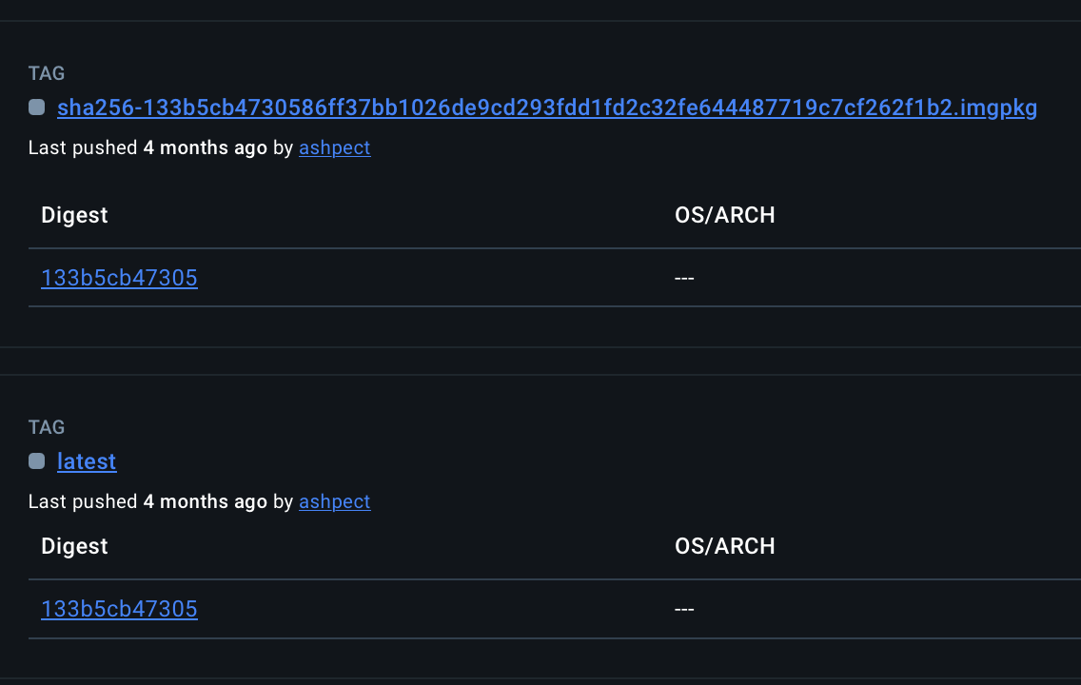
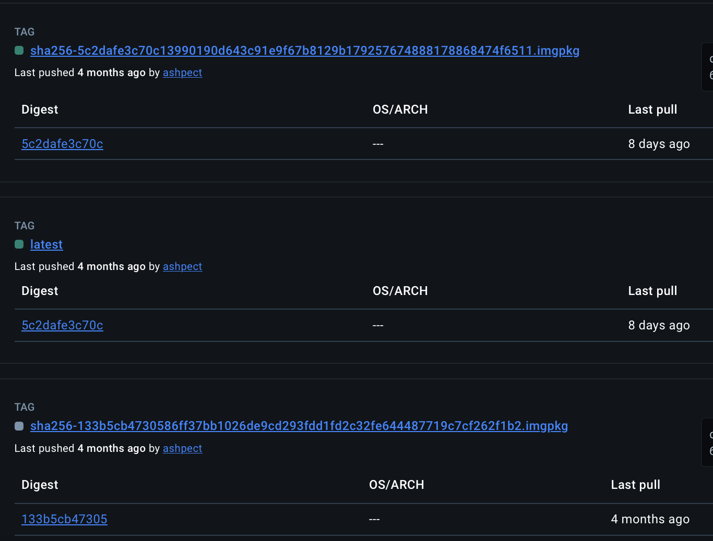
Imgpkg
Notes:
For eg : you can use a command such as imgpkg copy and it automatically references, sha-356 sums of the dependable images which we have in a .imgpkg file, you could actually form it easily with another tool or write you own if required.

Slide 8
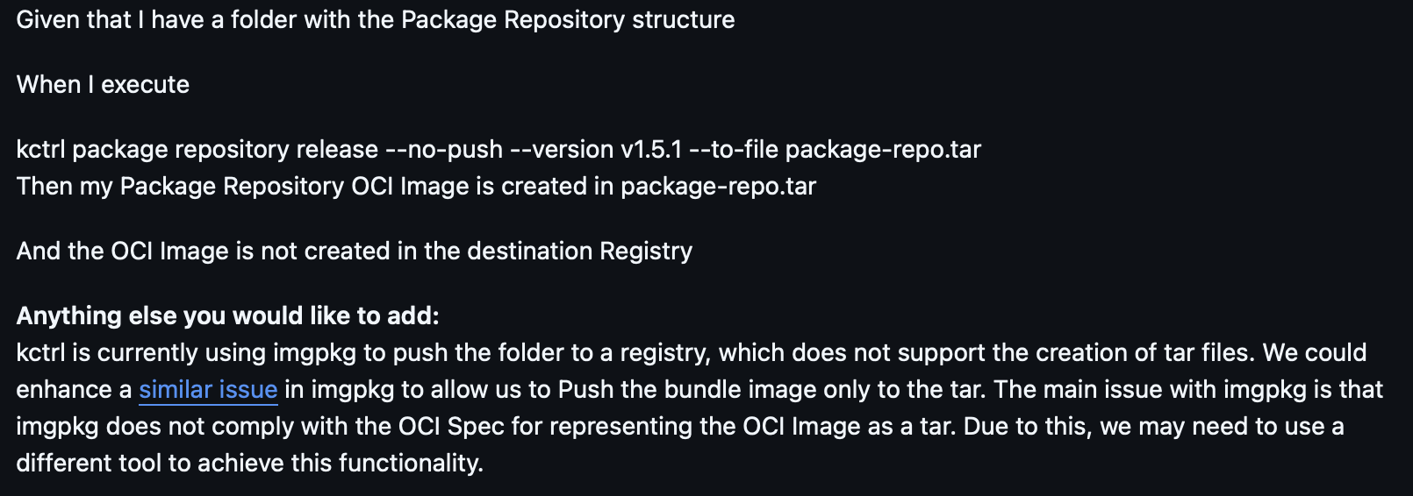
The Issue
Notes:
In layman terms, after we ‘ve copied ,we just wanted to add functionality of creating oci-tar of artifacts from kctrl before pushing.

Slide 9
Learnings
# 1 Don’t underestimate yourself !!
# 2 Don’t overestimate yourself !!
# 3 Communicate, Communicate, Communicate !!
Notes:
Mentors aren’t just for technical side of things, talk to them about it.

Slide 10
Learnings
# 1 Don’t underestimate yourself !!
# 2 Don’t overestimate yourself !!
# 3 Communicate, Communicate, Communicate !!
# 4 Be self-reliant. ‘Learn how to learn’ !!
Notes:
Your first priority should be to get a roadmap and learn how to learn. For the first week. Get yourself familiar. Don’t think you can directly start on something and even if you might have the skill set, it’s always good to get familier with the org, the other projects in case things go southhill.

Slide 11
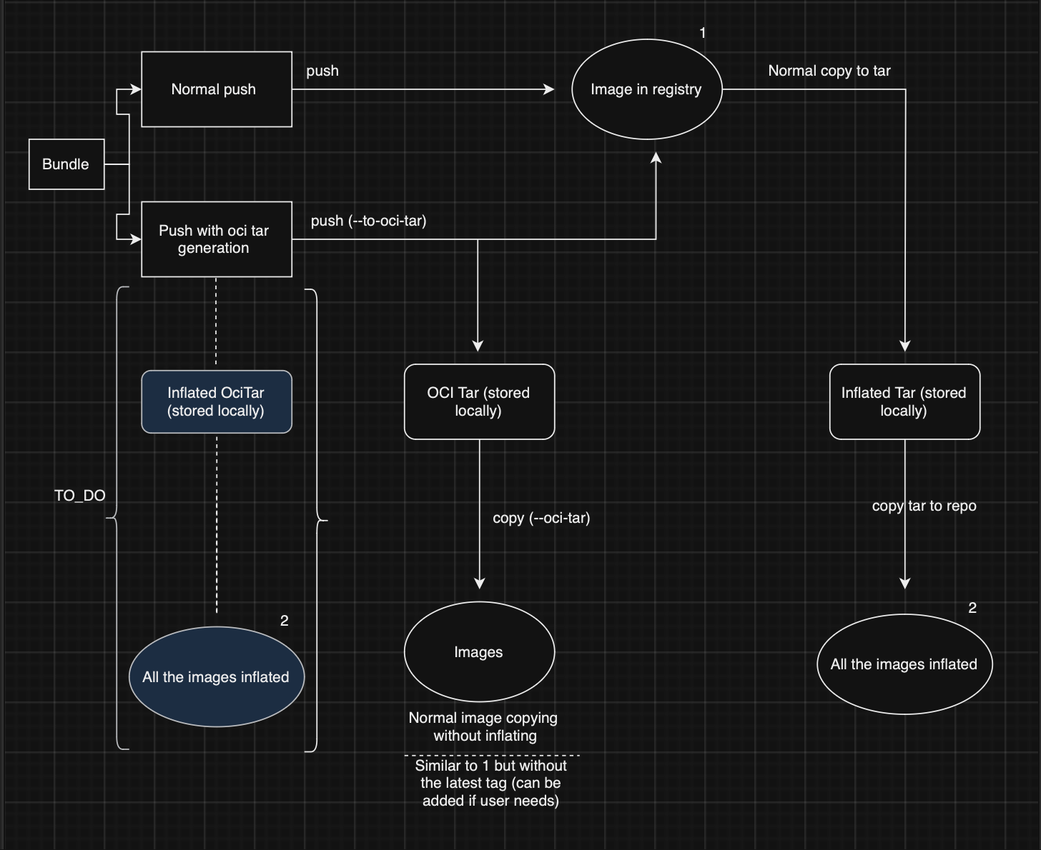
#5
Define a scope.
Make roadmap.
Make weekly goals.
Separate things on priority basis.
Weekly Checkups

Slide 12
Learnings
# 1 Don’t underestimate yourself !!
# 2 Don’t overestimate yourself !!
# 3 Communicate, Communicate, Communicate !!
# 4 Mentors are also human beings !!
# 5 Be self-reliant. ‘Learn how to learn’ !!
# 6 Define scope and timeline very well !!
# 7 Don’t be afraid to re-do things. Don’t get too attached. !!

Slide 13
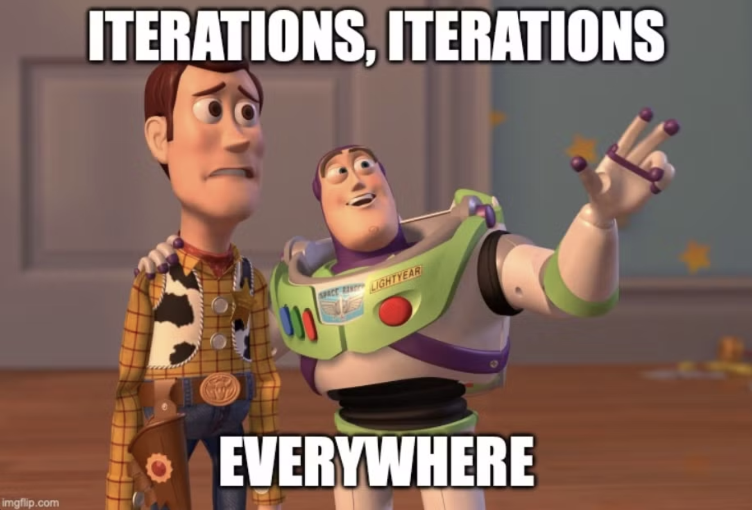


Slide 14
Technical Learnings
#1 Building Images from Scratch
#2 OCI Images and Artifacts
#3 Importance of OCI Compliant Ecosystem
#4 Writing CLI’s in go
#5 Buildkit Internals
#6 Creating and working with CRD’s
Notes:
If you see an opportunity of improvement and would work on it, jump on it.

Slide 15
The Journey Beyond
# 1 Find what you liked and go into the depths !!
- Went into the depths of image building.
Notes:
Now you know breadths

Slide 16
The Journey Beyond
# 1 Find what you liked and go into the depths !!
- Went into the depths of image building.
# 2 Leverage what you learnt !!
- Worked on startups, Buildkit/Docker/K8s in GSoC in Metacall.
Notes:
Now you know breadths

Slide 17
The Journey Beyond
# 1 Find what you liked and go into the depths !!
- Went into the depths of image building.
# 2 Leverage what you learnt !!
- Worked on startups, Buildkit/Docker/K8s in GSoC in Metacall.
# 3 Build your personal projects !!
- Learning through smaller projects.
Notes:
Now you know breadths

Slide 18
The Journey Beyond
# 1 Find what you liked and go into the depths !!
- Went into the depths of image building.
# 2 Leverage what you learnt !!
- Worked on startups, Buildkit/Docker/K8s in GSoC in Metacall.
# 3 Build your personal projects !!
- Learning through smaller projects.
# 4 Find like minded people !!
- Joined CNCF community in locations.
- Founding member and DevOps co-lead at GDSC IIT Roorkee.
- Building Katana at SDSLabs – a&d ctf platform on k8s.
Notes:
Now you know breadths

Slide 19
What next ?
# 1 Meeting Linux Torvalds in Person
# 2 Connect with like minded people
# 2 Complete personal OSS projects
# 3 Looking for challenging opportunities to work on
github.com/ashpect/lfxdemo
Notes:
Now you know breadths

